Slide 1
Plant Disease Detection
MATH 637 -Project Group 6
Akash panduga
Dheeraj reddy
Harshitha Lavu
Sai sujith reddy
S.S.V.Sri Harsha
Nikhil Mani Rakesh

Slide 2
INTRODUCTION
Plant disease detection involves the identification and management of diseases that affect crops and plants. Timely and accurate detection is crucial for preventing the spread of diseases, minimizing crop losses, and ensuring food security.
Several methods and technologies are employed for plant disease detection, ranging from traditional visual inspection to advanced technologies such as image processing, machine learning, and sensor-based systems.
Effective plant disease detection contributes to sustainable agriculture, reduces the environmental impact of pesticide use, and supports global efforts to ensure food security.
Embracing innovative technologies is key to addressing the challenges associated with plant diseases and promoting a resilient and productive agricultural sector.

Slide 3
Methodology
Data collection
Data Augmentation
Data splitting
Creating a Model
Model training
Prediction
Evaluation

Slide 4
Data Description:
The dataset is chosen from kaggle.
The dataset consists of 20638 images from three different Plants.
Pepper
Tomato
Potato
These images are of 15 different classes.

Slide 5
The 15 different classes are:
Pepper bell Bacterial_spot, Pepper bell healthy.
Potato Early blight, Potato Late blight, Potato healthy
Tomato Bacterial spot, Tomato Early blight, Tomato Late blight, Tomato Leaf Mold, Tomato Septoria leaf spot, Tomato Spider mites Two spotted spider mite, Tomato Target Spot, Tomato Yellow Leaf Curl Virus, Tomato mosaic virus, Tomato healthy

Slide 6
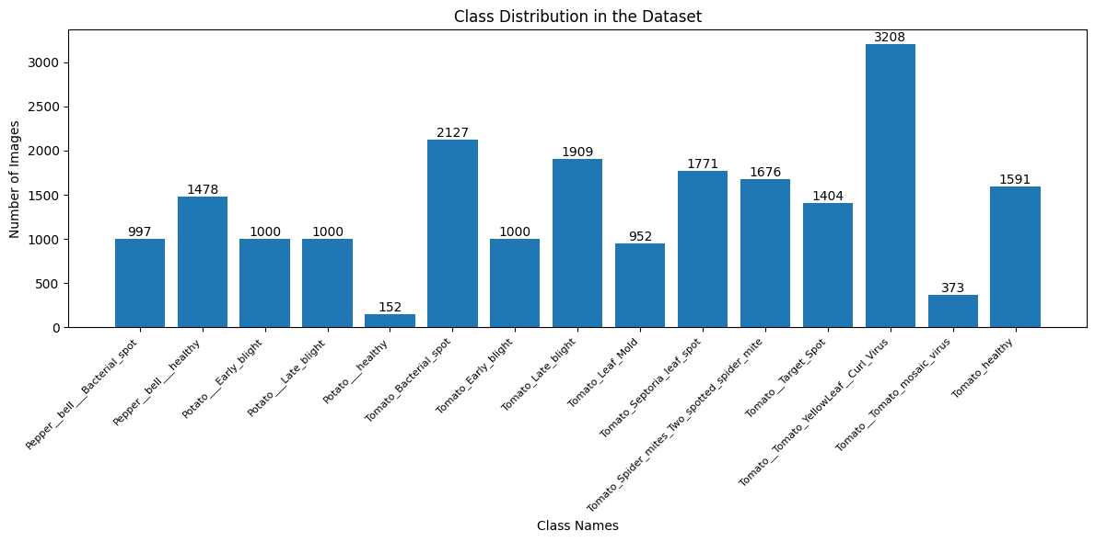
Images are resized to (180*180*3) to reduce complexity.
The below bar graph shows Class Distribution of the Dataset.

Slide 7
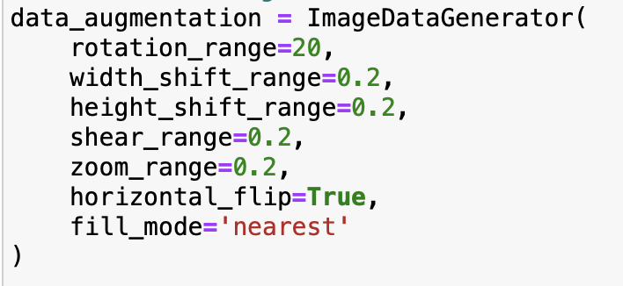
Data Augmentation:
The dataset is somewhat inconsistent. There are some classes with very less data(images) available for training.
In order to prevent DataGaps, Data-Augmentation can be used.
Making sure every class has minimum 1000 images.

Slide 8
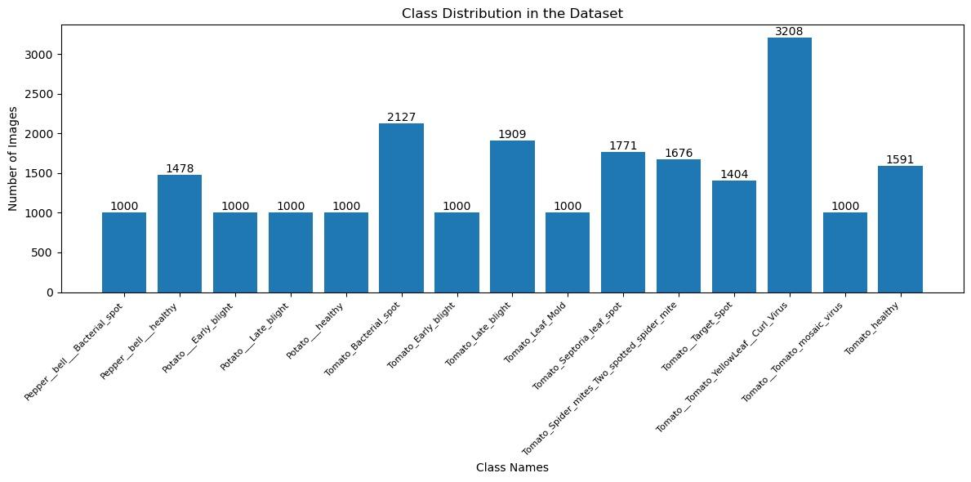
The below bar graph shows how many images are there in each class after Data Augmentation.

Slide 9
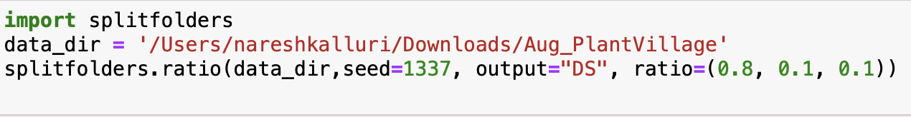
Data Distribution
We have split the dataset into Train, Valid and Test in the ratio of 0.8 : 0.1 : 0.1.
Code to split data :

Slide 10

Train Data
Train Data consists of 17727 images.
The bar graph shows the Class Distribution of Train Data.

Slide 11

Validation Data
Validation Data consists of 2212 images.
The bar graph shows the Class Distribution of Validation Data.

Slide 12
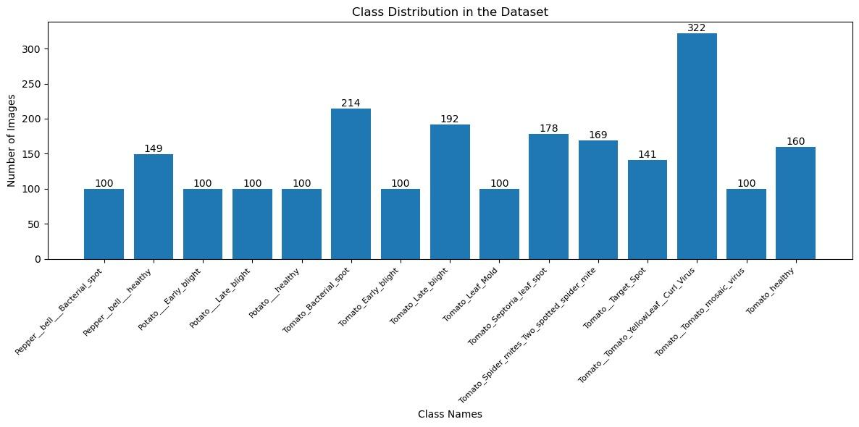
Test Data
Test Data consists of 2225 images.
The below bar graph shows the Class Distribution of Test Data.

Slide 13
Resnet Module
ResNet-50, short for Residual Network with 50 layers, is a deep learning architecture that belongs to the ResNet family. ResNet was introduced by Kaiming He, Xiangyu Zhang, Shaoqing Ren, and Jian Sun in their paper titled "Deep Residual Learning for Image Recognition," presented at the 2016 IEEE Conference on Computer Vision and Pattern Recognition (CVPR).
Residual Network (ResNet) is a Convolutional Neural Network (CNN) architecture that overcame the “vanishing gradient” problem, making it possible to construct networks with up to thousands of convolutional layers, which outperform shallower networks.
Residual blocks are an important part of the ResNet architecture. In older architectures such as VGG16, convolutional layers are stacked with batch normalization and nonlinear activation layers such as ReLu between them. This method works with a small number of convolutional layers—the maximum for VGG models is around 19 layers. However, subsequent research discovered that increasing the number of layers could significantly improve CNN performance.

Slide 14
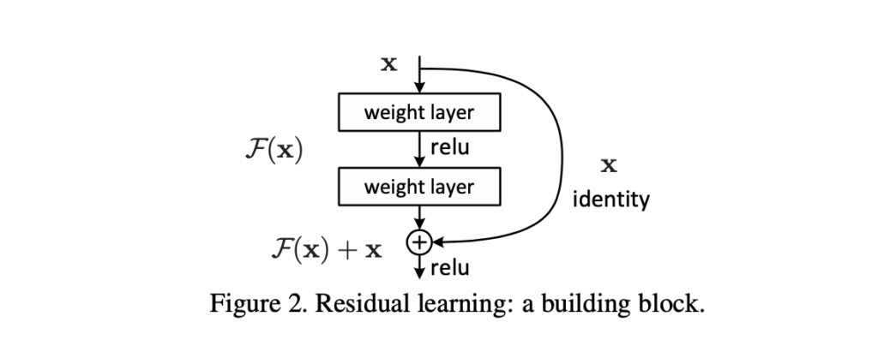
Resnet architecture

Slide 15
Resnet architecture
ResNet-50 has an architecture of 50-layer. ResNet uses a bottleneck design for the building block. A bottleneck residual block uses 1×1 convolutions, known as a “bottleneck”, which reduces the number of parameters and matrix multiplications. This enables much faster training of each layer. It uses a stack of three layers rather than two layers.
While ResNet-50 gained fame in image classification, it has found success in diverse applications. Its architectural principles are applicable to tasks such as object detection, image segmentation, and even non-image domains like natural language processing.

Slide 16
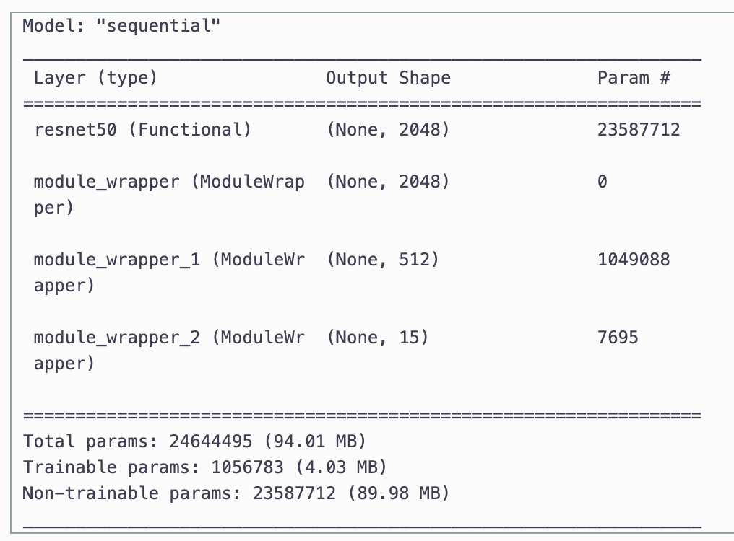
Resnet code
resnet_model = Sequential()
pretrained_model= tf.keras.applications.ResNet50(
include_top=False,
input_shape=(180,180,3),
pooling='avg',classes=15,
weights='imagenet')
for layer in pretrained_model.layers:
layer.trainable=False
resnet_model.add(pretrained_model)
resnet_model.add(Flatten())
resnet_model.add(Dense(512, activation='relu'))
resnet_model.add(Dense(15, activation='softmax'))

Slide 17
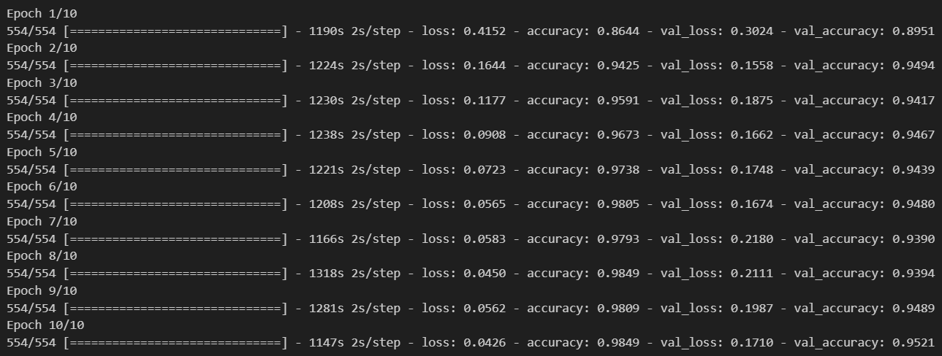
Resnet Training
resnet_model.compile(optimizer='adam',
loss='categorical_crossentropy',
metrics=['accuracy'])
epochs=10
history = resnet_model.fit(
train_ds,
validation_data=val_ds,
epochs=epochs
)

Slide 18
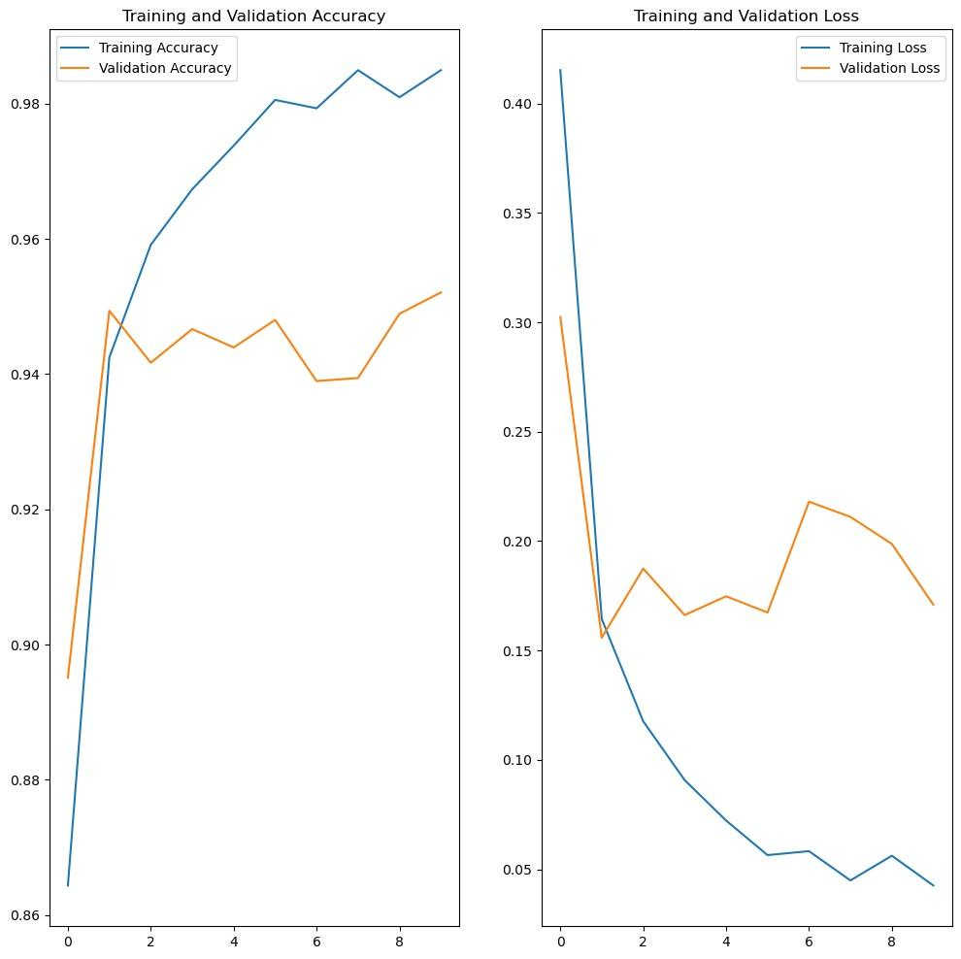
Results
The Training and Validation results are:
Metric | Training | Validation | Test
Accuracy | 98.49 | 95.21 | 96.04
Loss | 0.04 | 0.17 | 0.18

Slide 19
Results
The Test accuracy and loss:

Slide 20
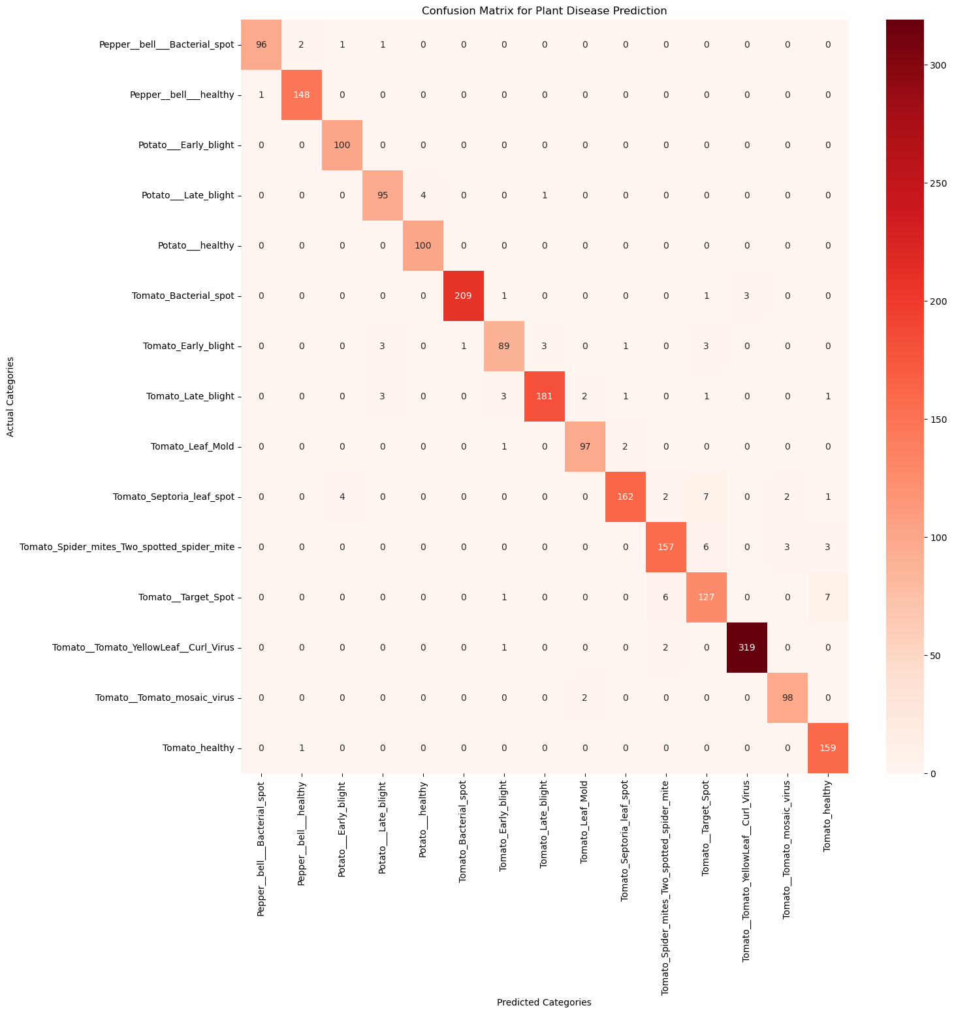
Confusion Matrix:
Below is the confusion matrix for true label and predicted label:

Slide 21
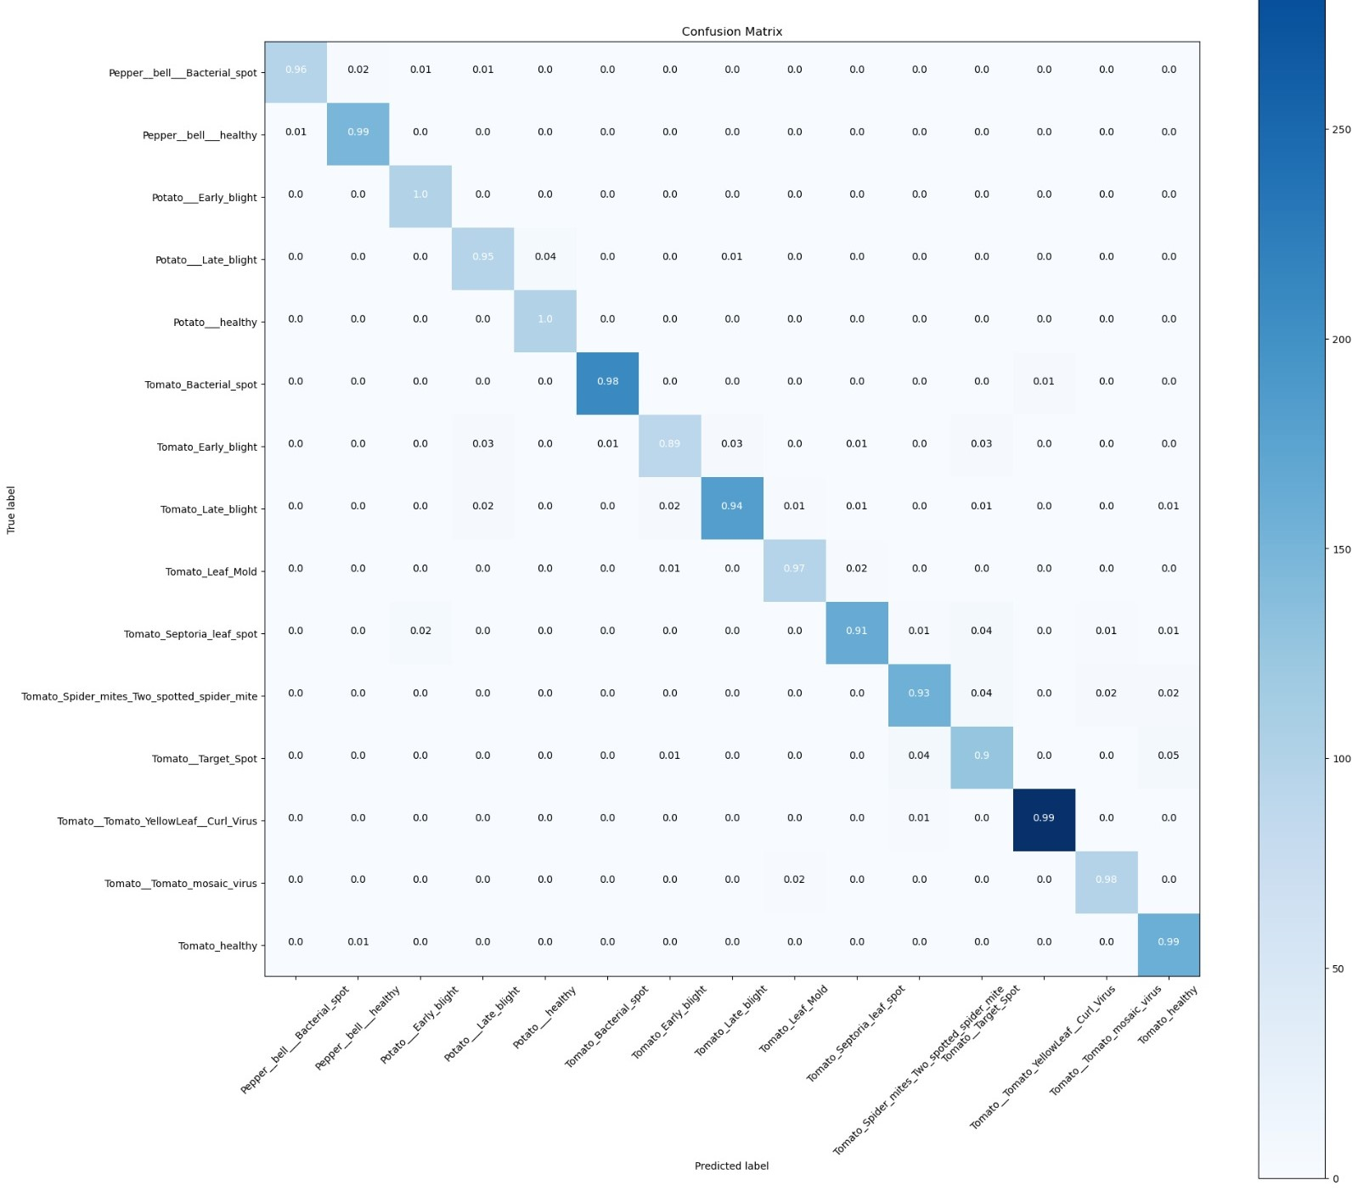
Confusion Matrix:
Below is the Normalised Confusion Matrix:

Slide 22
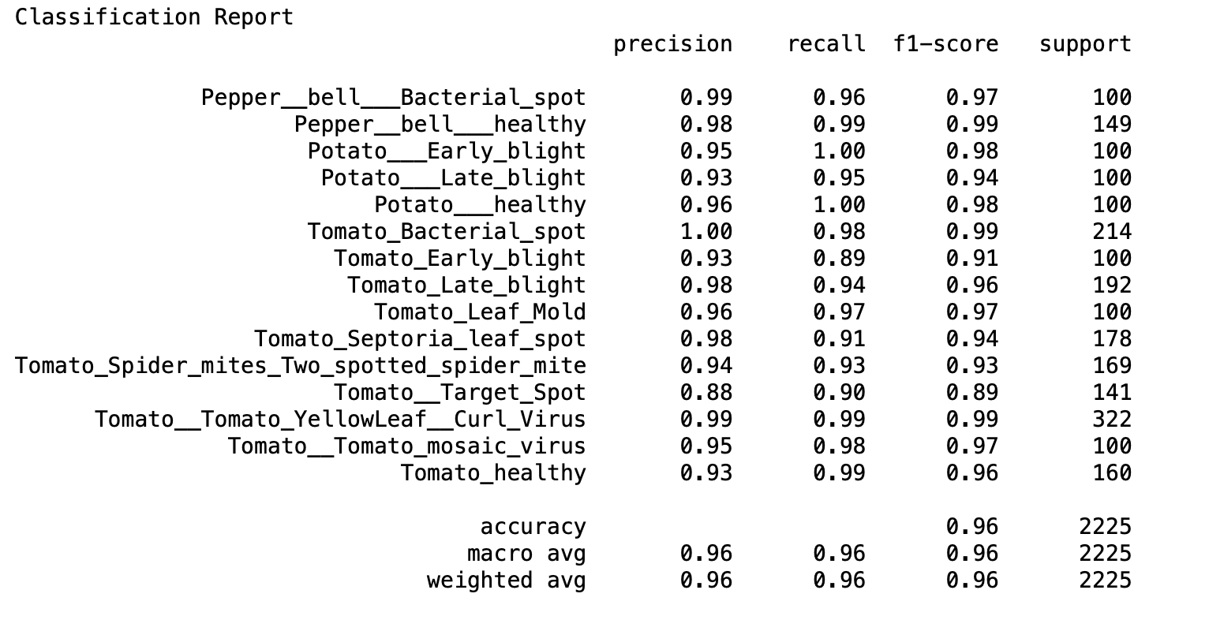
Here are precision, recall, f1-score and support:

Slide 23
What are the other ways we have tried?
We have tried CNN algorithm. But the accuracy is not good.
After we have tried with Resnet 50 without Data augmentation. Then it was better with 94% accuracy.
But for some classes the confusion matrix values are low like 88%. So, We have tried data augmentation for the classes which are having less than 1000 images.
We made minimum 1000 images for each class. There is improvement in the accuracy and in confusion matrix.
The accuracy is 96%.

Slide 24
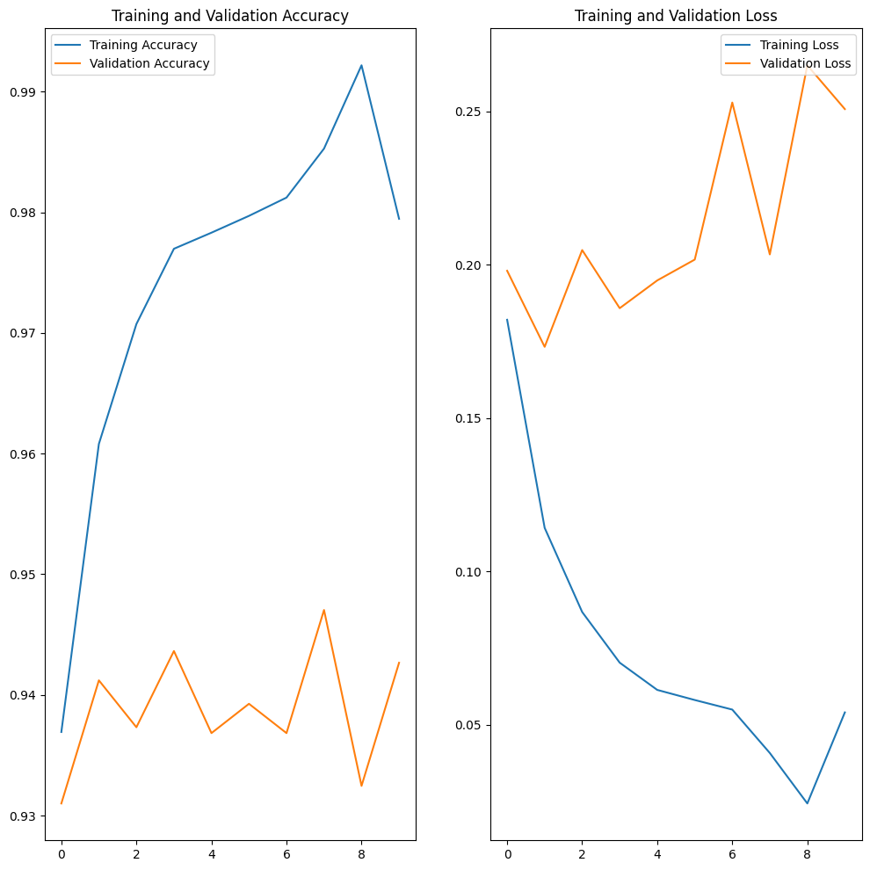
The results before Data augmentation:

Slide 25
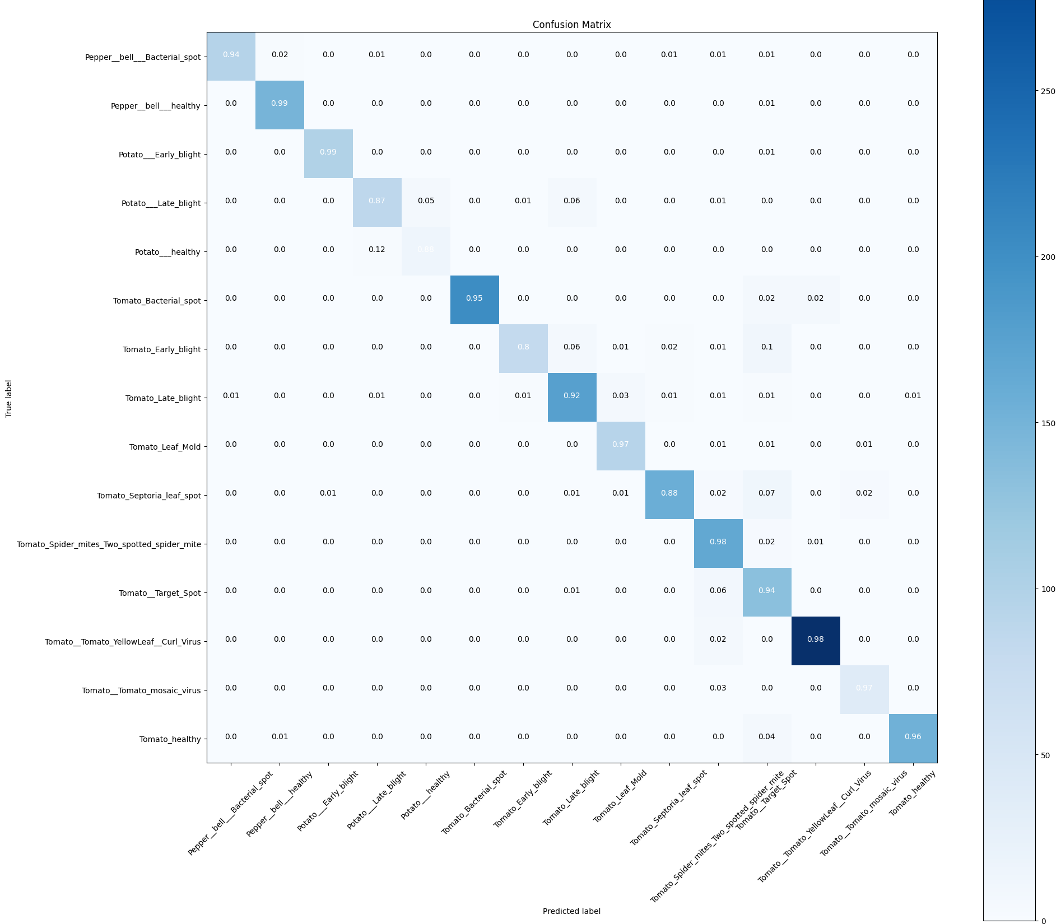
Confusion matrix before Data Augmentation:

Slide 26
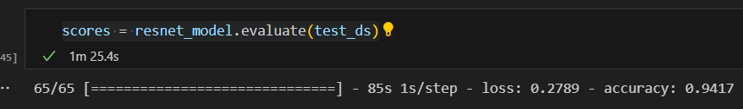
Test accuracy before Data Augmentation:
After Data Augmentation:

Slide 27
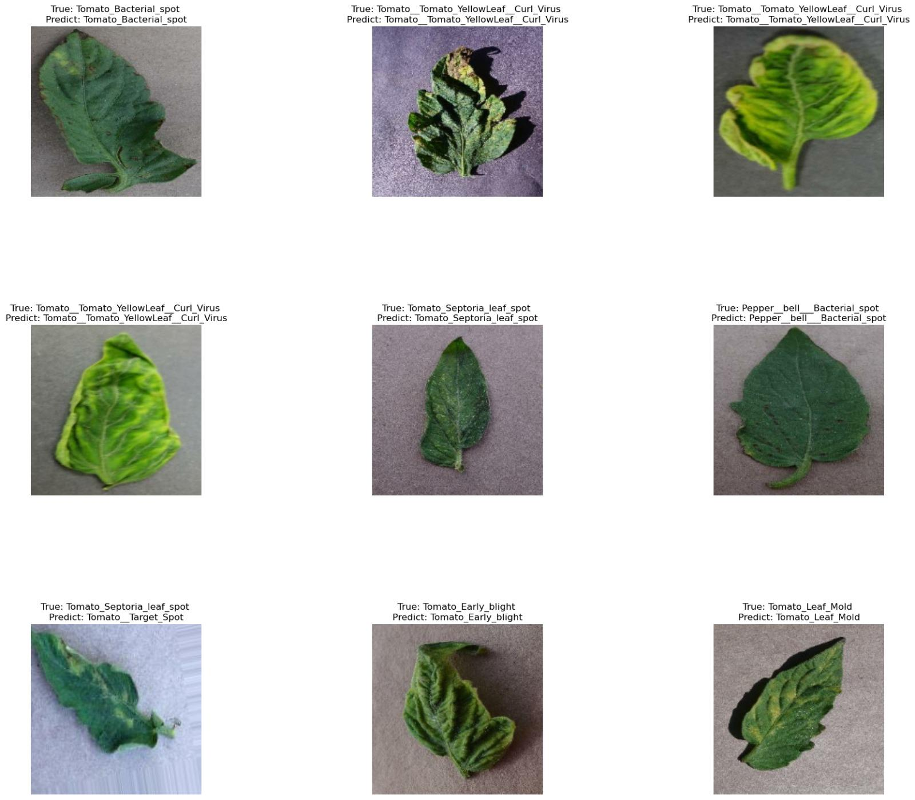
CONCLUSION:
Even though confusion matrix shows is very healthy, we have to check for the images whether the prediction is true or not.
So, we have selected some random images from the dataset and checked the true and predict labels.

Slide 28
THANK YOU
ANY QUESTIONS…?

